Slide 1
Kerberos Pt 1 No ticket touting here, does SharePoint add another head?
ITP327
Spencer Harbar Bob Fox
Notes:
SPENCE

Slide 2
About the speakers...
Spencer Harbar, MVP, MCTS, MCSD.NET, MCAD, MCSE, APM
www.harbar.net
Enterprise Architect working with some of Microsoft’s largest customers deploying Office SharePoint Server 2007.
15 years in Enterprise IT
ISPA Board Member
Bob Fox, MVP, MCTS
bobfox.securespsite.com
IT Professional with over 15 years experience
Specializing in SharePoint architecture and deployment
ISPA Board Member

Slide 3
Agenda
Authentication Methodologies
What is Kerberos?
Why Kerberos with SharePoint?
Implementing Kerberos with SharePoint
Common Problems
Best Practices

Slide 4
Two part session
Part One (this session):
Core Concepts
Standard Configuration
Testing, validation tools
Part Two (ITP370) 4.20pm:
“Advanced” Scenarios
More Tools
Q&A/Discussion

Slide 5
Authentication Mechanisms

Slide 6
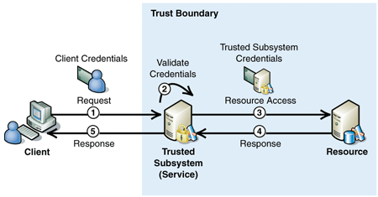
Trusted Subsystem
Resources are accessed by a “service account”
Caching & SQL Connection Pooling
with Windows Credentials
zero credential storage
SharePoint is predominately a Trusted Subsystem

Slide 7
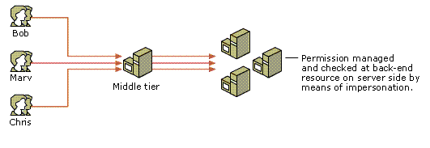
Impersonation/Delegation
Resources are accessed using client credentials
Allows end to end auditing etc
Caching / Pooling not possible

Slide 8
What is Kerberos?
Open, Extensible Authentication Protocol developed at MIT
Implemented in Windows 2000 and above Domains
Implemented as a Security Support Provider (SSP) and accessed through the SSP Interface (SSPI)
Default Authentication Protocol in Windows 2000 and above Domains
Windows 2003 adds support for certificate based smart cards

Slide 9
Benefits of Kerberos
Delegated Authentication
e.g. allows a web server to impersonate a client when accessing a database resource
Interoperability
with other implementations, open (IETF based)
Efficient
renewable session tickets
Mutual Authentication
allows verification of server identity
avoids unnecessary roundtrips to domain controllers
mature (10+ years)
a.k.a. “double-hop authentication”
Secure
Assumes network is un-trusted
Real encryption!

Slide 10
Comparing NTLM and Kerberos

Slide 11
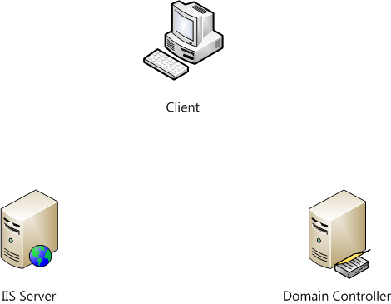
Windows Authentication (NTLM)
3 & 4
HTTP GET
HTTP: 401 WWW-Authenticate: NTLM Header
Acquire Credentials
Construct AuthN Token
HTTP GET with Username
HTTP 401: NTLM Challenge
NTLM Challenge Response
Username Token *
NTLM Challenge *
NTLM Challenge Response *
Authentication Success
HTTP 200: OK
10.
5.
9.
1.
7.
12.
6.
2.
8.
11.
Doesn’t Scale
Doesn’t Perform
Shared Secret over the wire
* Max NTLM Auths (2 by default) can be tweaked, but can tank your DCs

Slide 12
Windows Authentication (Kerberos)
HTTP GET
HTTP: 401 WWW-Authenticate: Negotiate or Kerberos
Request Service Ticket from KDC
Service Ticket returned
HTTP GET with authenticator
HTTP 200 OK
1.
3.
5.
2.
6.
4.
Approx one authN every five minutes

Slide 13
Comparing NTLM & Kerberos
 | NTLM | Kerberos
Cryptography | Symmetric | Symmetric and/or Asymmetric
Trusted 3rd Party | Domain Controller | Domain Controller with KDC Domain Controller and Enterprise CA
Supported Clients | Windows 9x, Me, NT4, 2000 and above | Windows 2000 and above
Features | Slow auth (pass thru) | Ticketing
 | No mutual AuthN | Mutual AuthN
 | No delegation | Delegation
 | Proprietary | Open Standard
 | Lamer data protection | Cryptographic data protection

Slide 14
Why Kerberos with SharePoint?

Slide 15
Security
Inter-server communications
End user authentication
Applications that require Delegation

Slide 16
Performance
More RPS possible
due to dramatically less AuthN round trips
Reduction in impact on Domain Controllers
Long user sessions
Performance myths:
“Kerberos makes SharePoint faster”
“One DC for every three WFEs”

Slide 17
Performance Comparison
 | Ave RPS | Ave PRT
"Standard" Session
Kerberos | 35.6 | 4.18
NTLM | 42.6 | 3.29
"Long” Session
Kerberos | 58.2 | 3.16
NTLM | 42.3 | 3.89

Slide 18
Functionality
Delegation
RSS Viewer
Excel Services to MSAS
Other applications
Custom code

Slide 19
Implementing Kerberos with SharePoint

Slide 20
SharePoint Comedy
You’ve all seen the lamer dialog:
SharePoint books say: “we recommend Kerberos but we’re not gonna tell you how to set it up, here’s a link to a non SharePoint KB“
Detailed badly on the web with a focus on single server scenarios.
Fixed with http://technet.microsoft.com/en-us/library/cc263449.aspx

Slide 21
Requirements
Windows 2000 and above
a TCP/IP Network
DNS (hosts files still work)
an Active Directory Domain
Consistent Time Service
Service Principal Names (SPNs)

Slide 22
Where?
SQL Communications
SQL Server Service Account
Web Applications
Inc. Central Admin & SSP Admin
End user authentication
Shared Services
For each SSP
Web Services
Farm SQL Connections

Slide 23
How
DNS
Always use A records!
Don’t use Aliases (CNames) for Web Applications
Active Directory
Implement “Service Accounts” for Application Pool Identities

Slide 24
How
Active Directory Attributes
Service Principal Names (SPNs)
Delegation (if needed)
SharePoint
STSADM
IIS7
Disable Kernel Mode Authentication
Central Administration

Slide 25
Service Principal Names
Notation is key PROTOCOL/HOST:PORT DOMAIN\user
Example: http/intranet SHAREPOINT\SPContent
Port is not required when using default port.
Best Practice: SPN for both hostname and “fully qualified” name: http/intranet SHAREPOINT\SPContent http/intranet.sharepoint.com SHAREPOINT\SPContent

Slide 26
Shared Services
Install Infrastructure Updates (or later) on all servers in farm
Add Registry Key HKLM\Software\Microsoft\Office Server\12.0\KerberosSpnFormat = 1
Reboot!
SPNs for each machine MSSP/server1:56737/SharedServices1 domain\user1 MSSP/server1:56738/SharedServices1 domain\user1
Configure Shared Services Stsadm.exe –o setsharedwebserviceauthn -negotiate

Slide 27
PAC Validation
Privilege Attribute Certificate validation takes place by default (on Windows 2003)
Still making use of Secure Channel
causes delays
perceived poor performance
Windows 2003 SP2 introduces ability to disable (90673)
DWORD: HKLM\System\CurrentControlSet\Control\Lsa\Kerberos\Parameters\ValidateKdcPacSignature = 0
On Windows 2008 default is off (0)

Slide 28
Implementing Kerberos for SHAREPOINT
SQL Server, Central Administration, Web Applications, Shared Services

Slide 29
Testing and validation
Don’t test from DC or Web Server!
Windows Security Auditing
Kerberos Auditing
Kerbtray and Klist
Netmon and Fiddler (etc)
IIS Log Files, IIS7 Failed Request Tracing
Above all, be patient!
Use IISRESET

Slide 30
Common Issues
Issue
Best Practice
Mis-configured SPNs
Duplicate SPNs
PAC Validation
Host name issues
Load Balancing Myths
IE6 Clients use NTLM
Use correct notation!
Use new –X switch
Disable PAC Validation
Never use CNames!
Setup Web App Correctly
Don’t use CNames
or MSKB 911149
DON’T USE ALIASES (Cnames) for Web Applications!

Slide 31
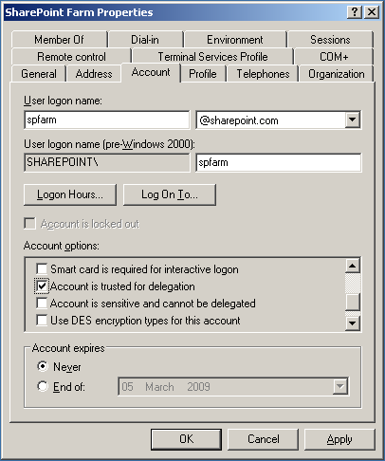
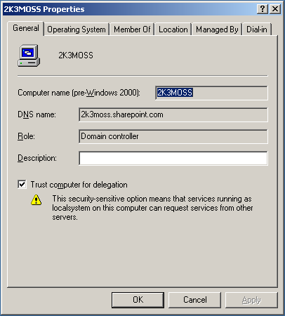
Windows 2003

Slide 32
Recommendations
Windows 2008 if at all possible
Infrastructure Updates
NTLM first, then enable Kerberos
Patience!
Script configuration after extensive testing

Slide 33
Essential Tools
CLI: Setspn.exe
Windows 2003: part of Resource Kit or separate download http://www.microsoft.com/downloads/details.aspx?familyid=9d467a69-57ff-4ae7-96ee-b18c4790cffd
GUI: Adsiedit.msc
Windows 2003: part of support tools (on Windows CD)
Kerbtray.exe http://www.microsoft.com/downloads/details.aspx?familyid=4E3A58BE-29F6-49F6-85BE-E866AF8E7A88
Klist.exe http://www.microsoft.com/DownLoads/details.aspx?familyid=1581E6E7-7E64-4A2D-8ABA-73E909D2A7DC
Both part of the Windows 2003 Resource Kit Tools http://www.microsoft.com/downloads/details.aspx?familyid=9d467a69-57ff-4ae7-96ee-b18c4790cffd
Network Monitor 3.2 http://www.microsoft.com/downloads/details.aspx?familyid=f4db40af-1e08-4a21-a26b-ec2f4dc4190d
DelegConfig http://www.iis.net/downloads/default.aspx?tabid=34&g=6&i=1434

Slide 34
Takeaways
It’s easy!!
However, tons of misinformation and myths on the ‘net
DCOM Configuration
Delegation
Dodgy Blog Posts!
The best links:
Configure Kerberos authentication (Office SharePoint Server) http://technet.microsoft.com/en-us/library/cc263449.aspx
Kerberos Authentication Tools and Settings http://technet.microsoft.com/en-us/library/cc738673.aspx
Troubleshooting Kerberos Errors http://www.microsoft.com/downloads/details.aspx?FamilyID=7DFEB015-6043-47DB-8238-DC7AF89C93F1
Ken Schaefer’s Blog http://www.adopenstatic.com/cs/blogs/ken

Slide 35
In part two...
More on Shared Services & Search
Excel Services
More details on Known Issues and “myths”
Additional Tools
Announcing Configuration Wizard
Q&A / Discussion
ITP370 4.20pm

Slide 36
Thank you for attending!
Post conference DVD with all slide decks
Sponsored by

